Slide 1
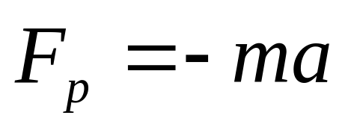
Limitations of Newton’s lows
The speed of motion << c
Inertia frame
its velocity is constant relative to one another
a
m₂a
m₃a
If frame s’ moves with acceleration, it is not an inertial frames.
a
m₁
m₂
Noninertial frames and pseudoforces
m₃
How can we do?

Slide 2

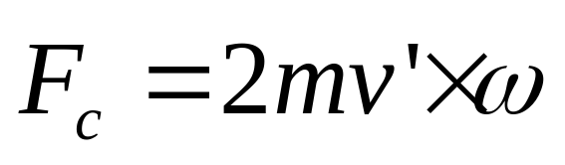
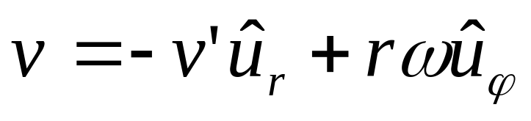
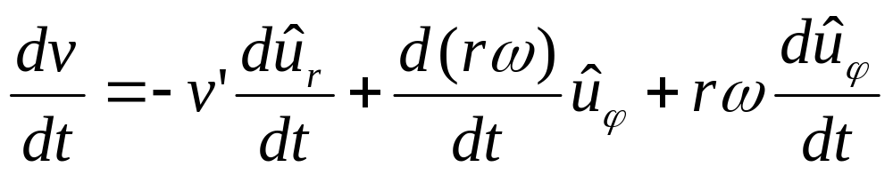
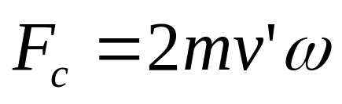
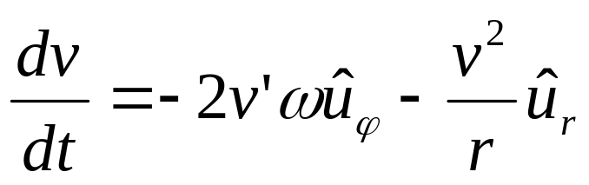
What is the frame?
Noninertial frames with rotation
v’
Coriolis force
F=mv²/r

Slide 3
Chapter 6
Momentum

Slide 4
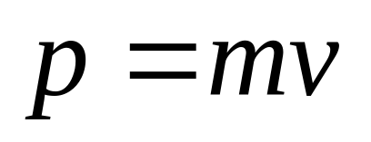
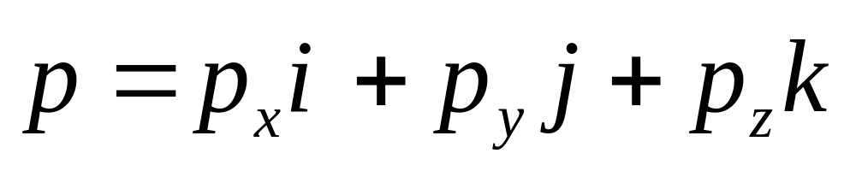
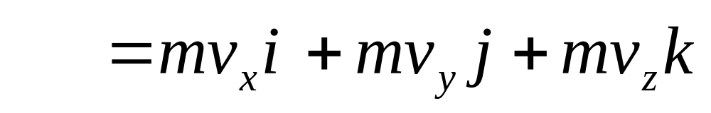
Linear momentum
The momentum p of a body is defined as:

Slide 5
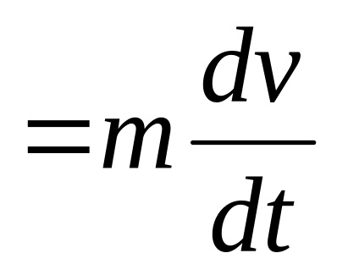
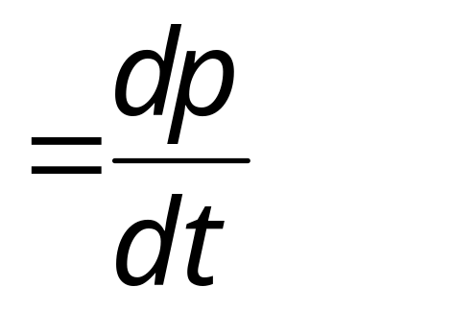
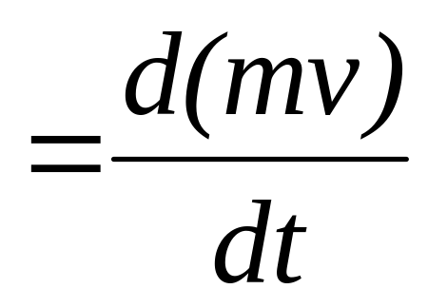
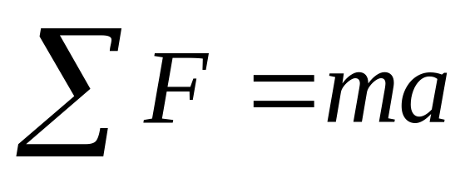
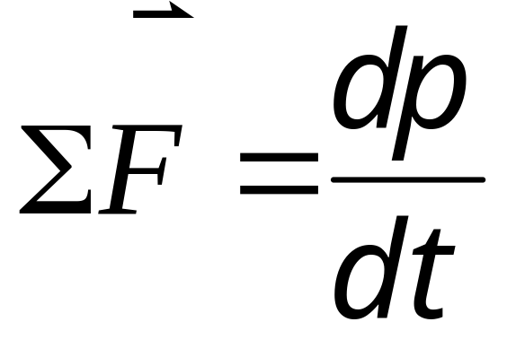
This is another form of Newton’s second law.

Slide 7
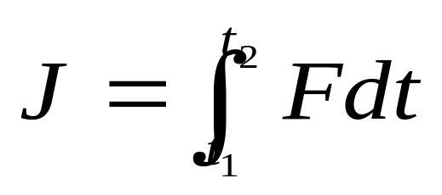
F
What is the force between two bodys?
F(t)
impulse
F_{av}
The area under the F(t) curve is J.
J = F_{av} (t₂-t₁) = F_{av} Δt
t₁ t₂
t

Slide 8
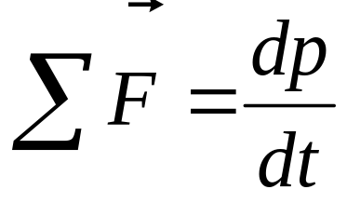
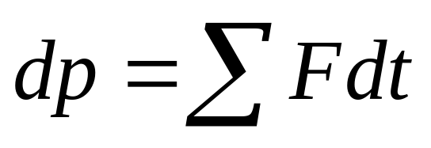
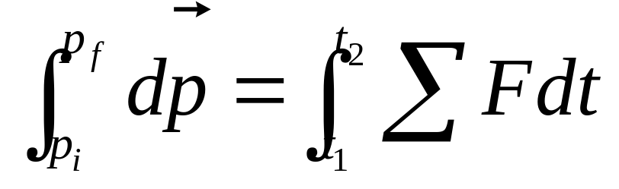
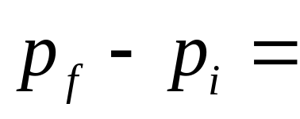
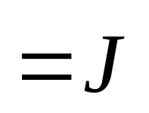
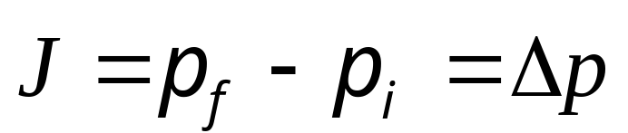
y
J
impulse-momentum theorem.
p_{f}
p_{i}
x

Slide 9
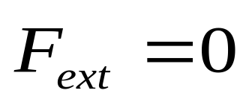
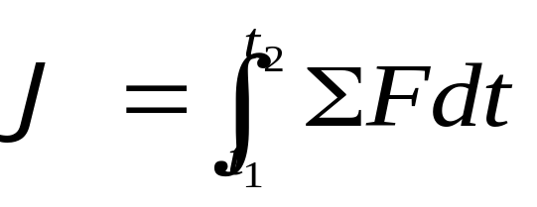
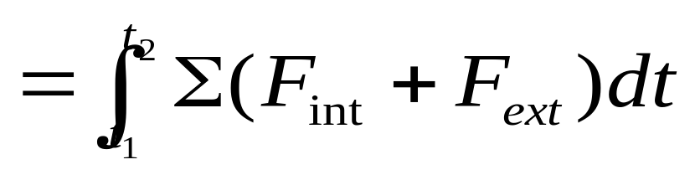
Conservation of momentum
F_{ext}
F_{ext}
F_{int} F_{int}

Slide 10
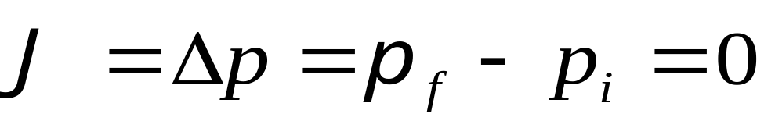
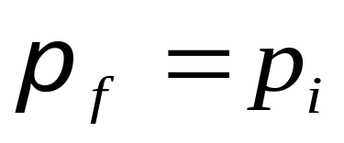
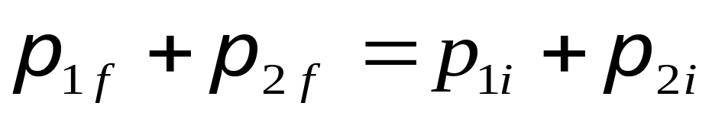
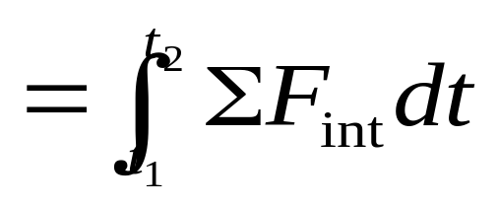
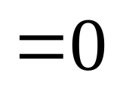
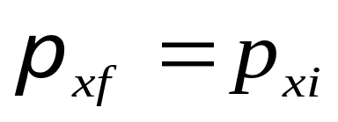
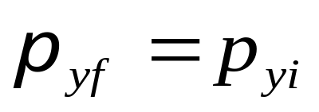
Conservation of momentum
The frame of reference.
Although p₁and p₂ may both change, their vector
sum stays the same.
F_{int} F_{int}
Conservation of momentum consists of three components formulas.

Slide 11
Collision in 1-D

Slide 12
Collision in 1-D

Slide 13
Collision in 1-D

Slide 14
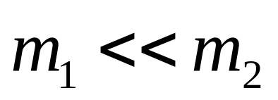
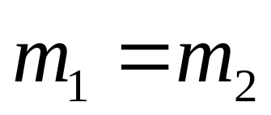
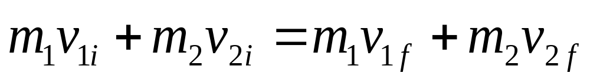
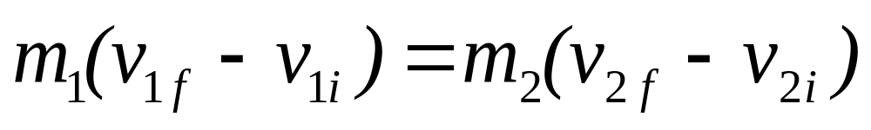
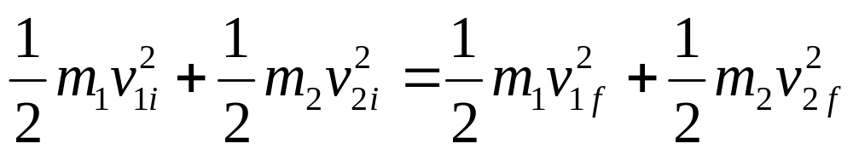
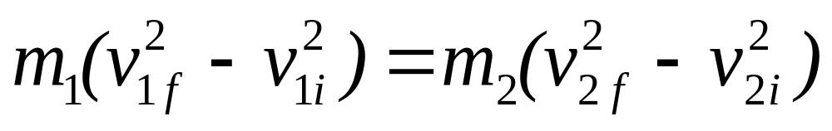
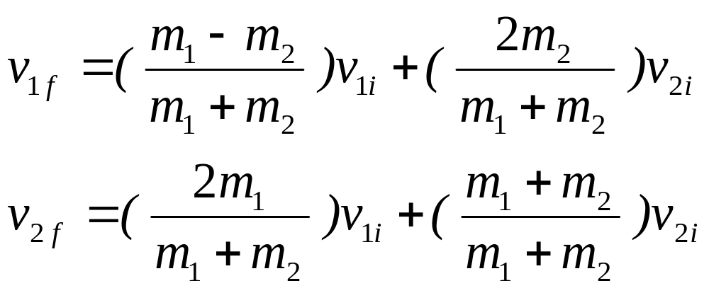
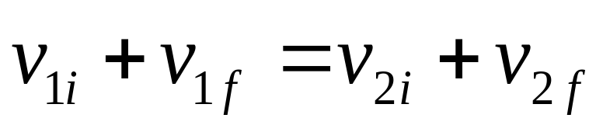
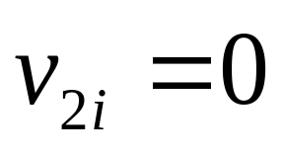
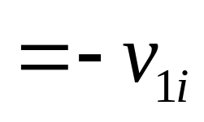
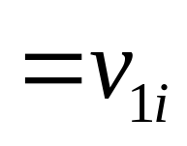
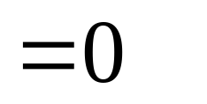
Collision in 1-D
v
v
v
v
For elastic collision

Slide 15
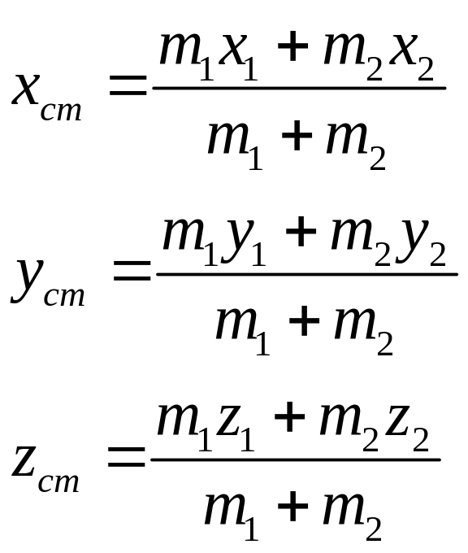
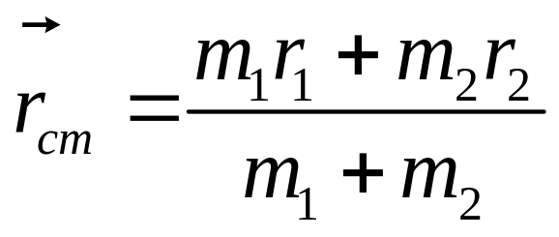
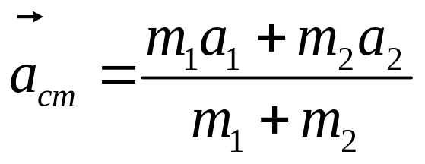
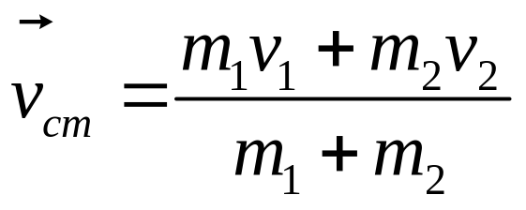
Two-particle systems
cm frame
The center-of-mass reference frame
m₁
m₂
C
r_{cm}
r₁
r₂
The center of mass
lab frame
The laboratory reference frame

Slide 16
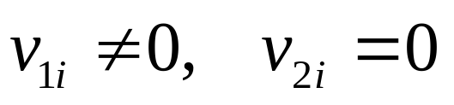
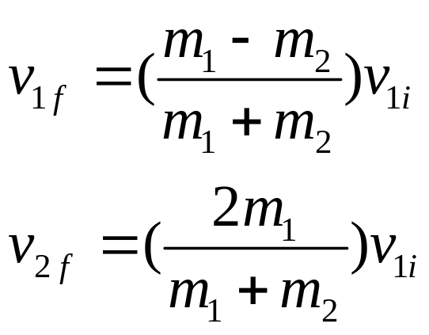
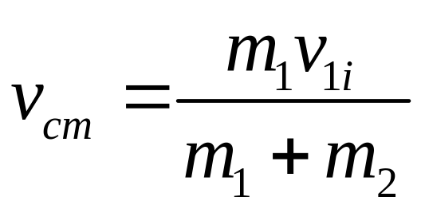


lab frame
m₁
m₂
v₁
v_{cm}

Slide 17








m₁
m₂
CM Frame
v₁

Slide 18
lab frame
cm frame
v_{cm}
v_{cm}

Slide 19





For completely inelastic collision
m₂
m₁
v_{1i}
m₁ + m₂
v_{f}

Slide 20





lab frame
cm frame
v_{cm}
v’_{cm}

Slide 21

































Example
For elastic collision
m₁ =1
m₁ =1
m₂ =2
m₂ =2
CM Frame
m₂ =2
m₁ =1
m₂ =2
m₁ =1
a=?

Slide 22
CHAP. 6
Problems
10, 14, 16, 17, 19 (P136)

